Slide 1
House Price Prediction
Presented By:
Mallikarjun Narra
Sai Sri Harsha Chakravarthula
Sindhu Kandimalla
Vamsi Soleti

Slide 2
ROLES
Mallikarjun Narra : Worked on collection of data on different variables like number of bathrooms, number of bedrooms, floors, sqft living, waterfront etc., and also performed analysis on the collected data like cleaning and normalizing the data, filling missing values.
Sai Sri Harsha Chakravarthula: Worked on Selecting appropriate model like Linear regression and training the model with the correct input data to get accurate results.
Sindhu Kandimalla: Worked on evaluating the model by performing R sqaured value to check whether the model is best fit or not and also worked on testing different models to check the best fit.
Vamsi Soleti: Worked on interpretation of results for drawing conclusion and created report and presentation.

Slide 3
ABSTRACT
This project provides a high-level overview of utilizing machine learning models to forecast home prices, which is important given the regularity with which they fluctuate. Since these forecasted values can be used to make more informed financial and strategic decisions. We employ regression analysis to generate inferences about real estate based on sets of data that are highly connected with one another in this project.

Slide 4
MOTIVATION
Helps real-estate investors in decision-making and also the future predictions male help the investor on when and where to invest their money.
Helps buyers and sellers in profit making and also getting the house for the fair price.
Helps in providing insights to the broader economy by following changes over time and place based on the regression accurate values.

Slide 5
DESIGN AND MILESTONE
Collected data based on the different variables like number of bedrooms and bathrooms, square footage etc.,
Cleaned the unwanted data, filled the missing data, normalized the data and transformed variables
Did research on identifying patterns that might be useful in drawing best conclusions.
Tested the model with different values by performing r square value to find the best fit model.
Interpreted the results to draw conclusion on house price prediction.

Slide 6
DATA DESCRIPTION AND ANALYSIS
Data Description:
Data which we used is collected from housing market trends, real estate market. It consists of over 200 observation and over 15 variables.
Data Analysis:
We performed data analysis by understanding patterns and relationships. We used visualizations like histograms, scatterplots, bar graphs to represent data graphically. We also performed correlation analysis and hypothesis analysis to test the relations between variables.

Slide 7
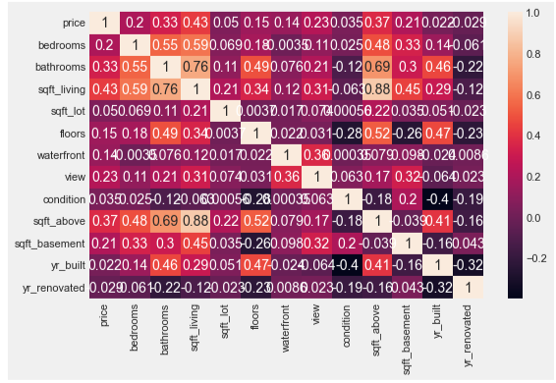
CORRELATION HEATMAP BETWEEN VARIABLES

Slide 8
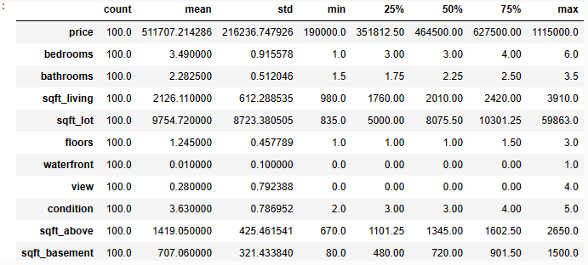
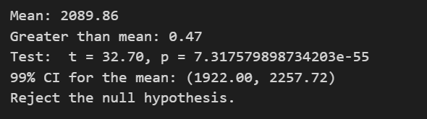
FOLLOWED STEPS:
1)Calculated mean and proportions of different variables over a sample size of 100.

Slide 9
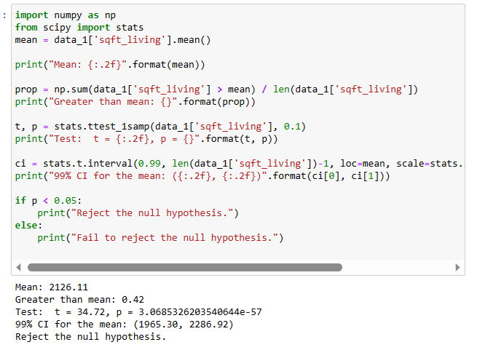
2)Performed hypothesis test and found confidence interval to know the given data supports the evidence of null hypothesis.

Slide 10
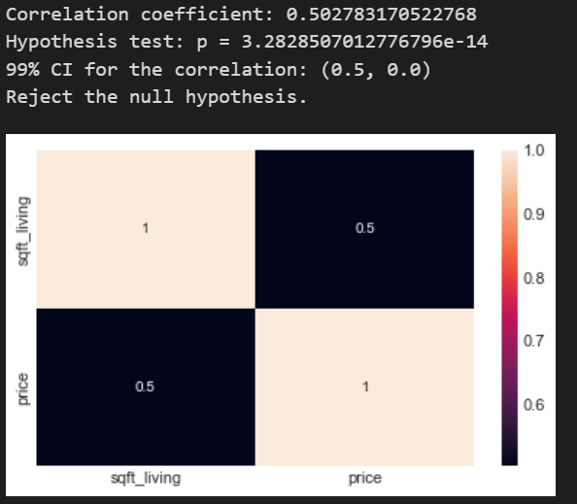
3)Performed correlation between two variables. One is a target variable like price and the other is our own variable like sqft_living.

Slide 11
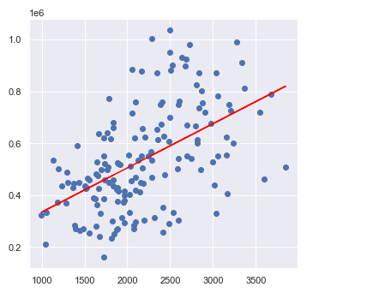
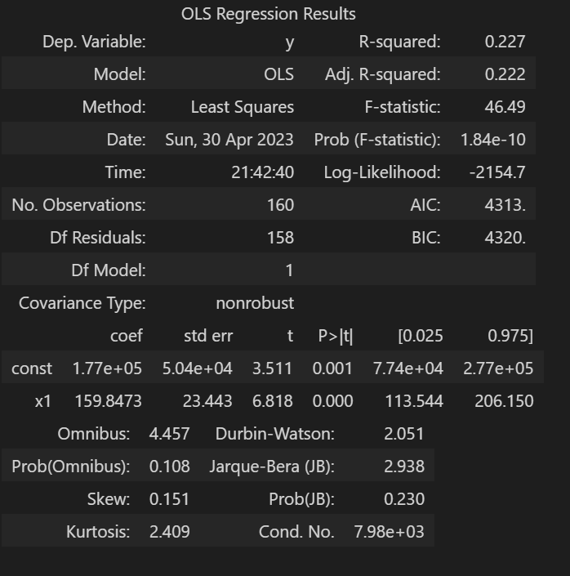
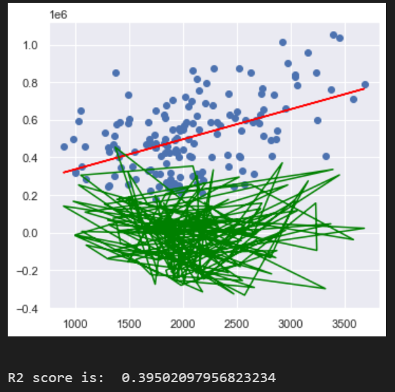
4)Performed linear regression testing to check whether this model gives the accurate results of the target variable by considering our own variable as versus.
In order to say this as the best model we performed R square calculation.

Slide 12
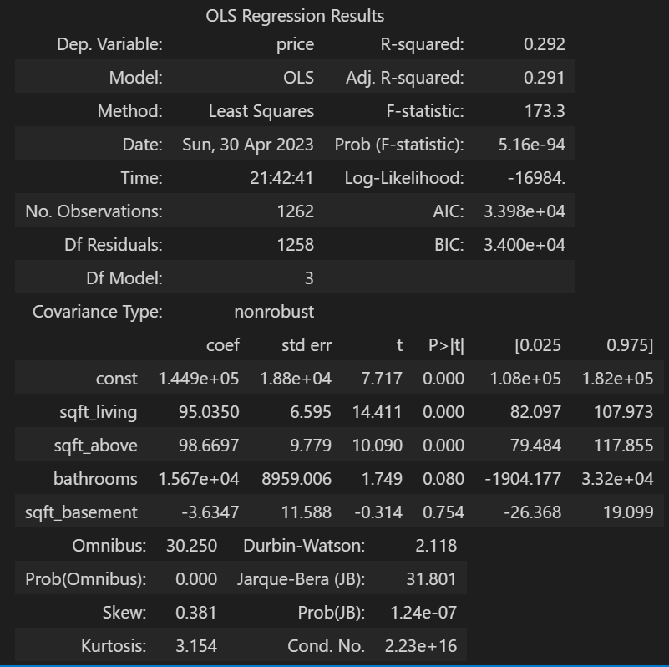
When using multiple variables['sqft_living', 'sqft_above', 'bathrooms','sqft_basement'] to determine target variable(“Price”) using OLS model .

Slide 13
Multi Regression Equation is
Y = 1.26e+05 + 94.7107 * (sqft_living) + 88.5546 * (sqft_above) + 2.701e+04 *(bathrooms) + 6.1561 * (sqft_basement)
Adjusted R2 score is : 0.2906849083077232

Slide 14
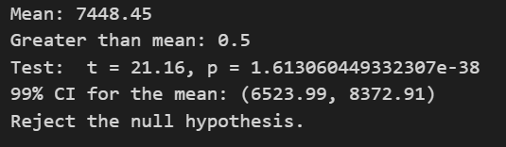
2)Performed hypothesis test and found confidence interval to know the given ['sqft_lot'] null hypothesis is the majority of the houses have the ['sqft_lot’] less than the mean of the ['sqft_lot’] in the data set for 100 samples.

Slide 15
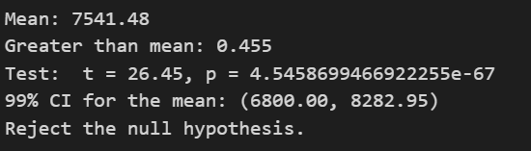
2)Performed hypothesis test and found confidence interval to know the given ['sqft_lot'] null hypothesis is the majority of the houses have the ['sqft_lot’] less than the mean of the ['sqft_lot’] in the data set for 200 samples.

Slide 16
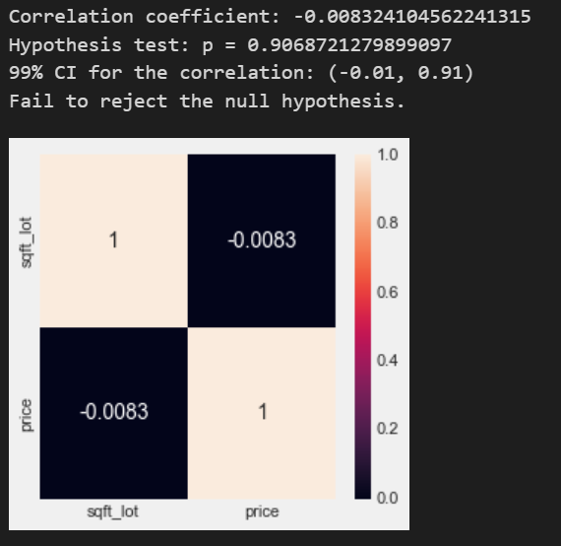
3)Performed correlation between two variables. One is a target variable like price and the other is our own variable like sqft_lot.

Slide 17
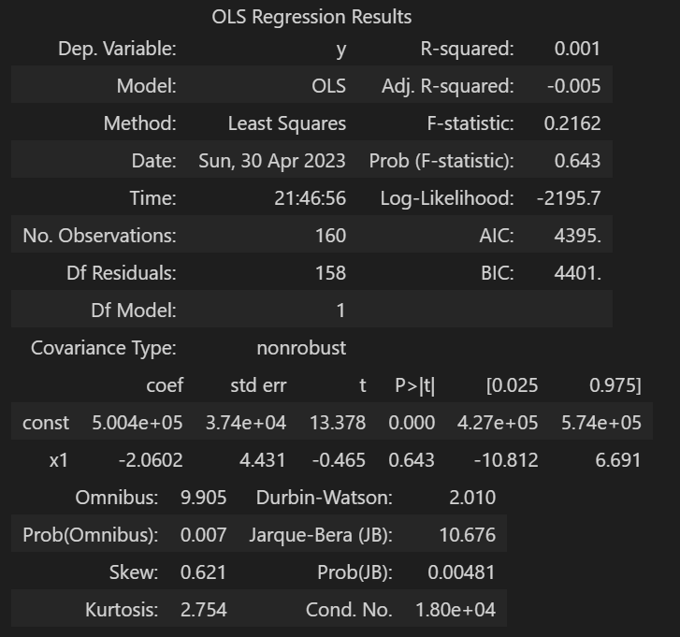
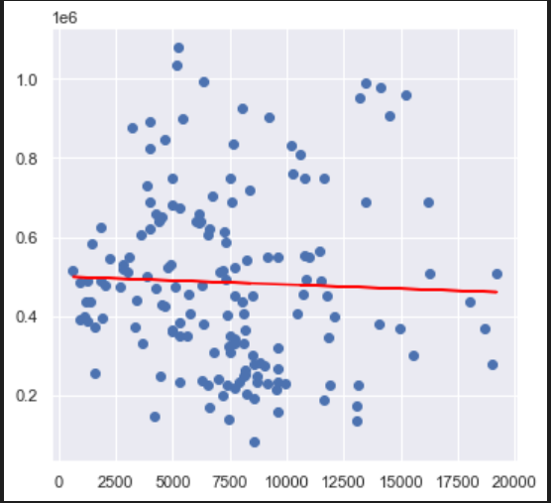
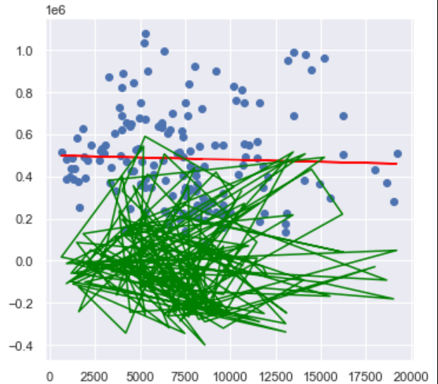
When using multiple variables['sqft_living'] to determine target variable(“Price”) using OLS model . R2 score is: -0.012727450273535501

Slide 18
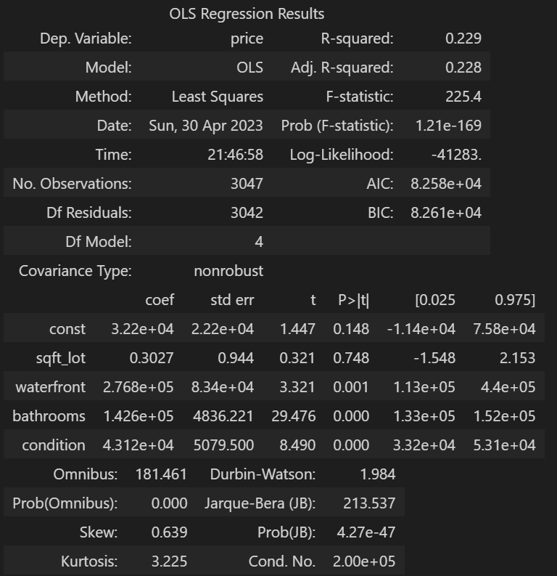
Adjusted R2 score for multi variables ['sqft_lot', 'waterfront', 'bathrooms','condition’] is 0.22759786323666764
The multi regression equation is : Y = 3.22e+04 + 0.3027 * (sqft_lot) + 2.768e+05 * (waterfront) + 1.426e+05 * (bathrooms) + 4.312e+04 * (condition)

Slide 19
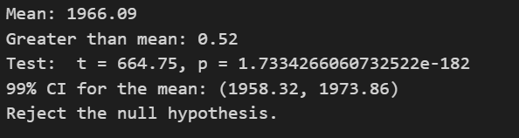
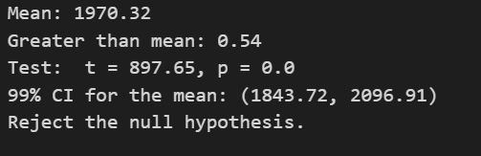
Performed hypothesis test and found confidence interval to know the given ['yr_built’] null hypothesis is the majority of the houses have the ['yr_built’] less than the mean of the ['yr_built’] in the data set for 100 samples.
Performed hypothesis test and found confidence interval to know the given ['yr_built’] null hypothesis is the majority of the houses have the ['yr_built’] less than the mean of the ['yr_built’] in the data set for 200 samples.

Slide 20
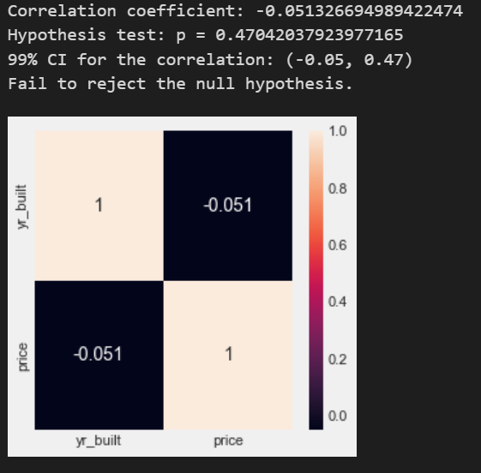
Performed correlation between two variables. One is a target variable like price and the other is our own variable like 'yr_built.

Slide 21
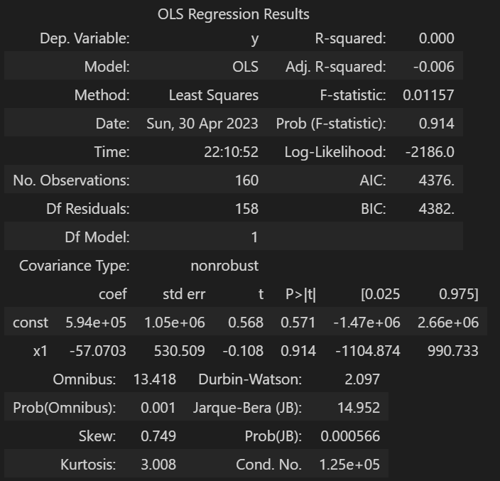
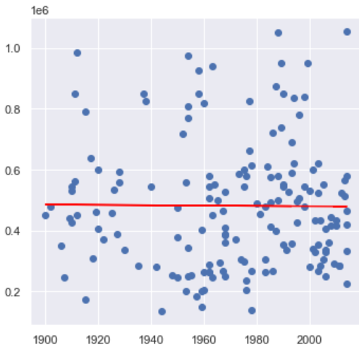
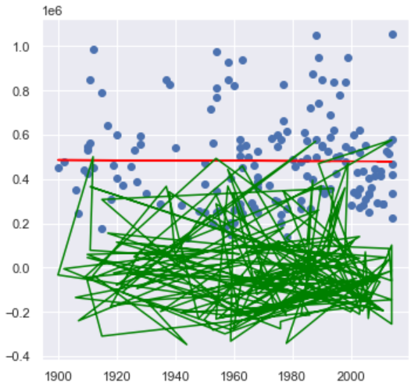
When using multiple variables[‘yr_built'] to determine target variable(“Price”) using OLS model . R2 score is: 0.002492263572493103

Slide 22
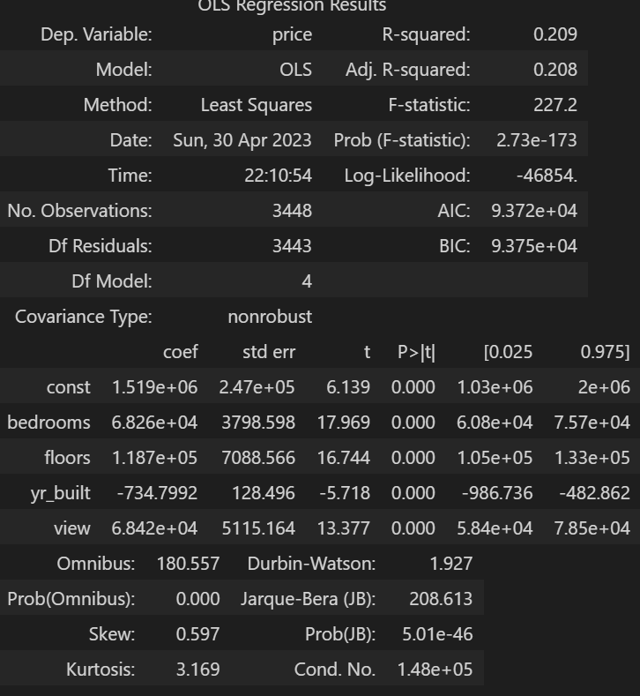
Adjusted R2 score for multi variables ['bedrooms', 'floors', 'yr_built','view']is 0.20790334785339315
The multi regression equation is : Y = 1.519e+06 + 6.826e+04 * (bedrooms) + 1.187e+05 * (floors) -734.7992 * (yr_built) + 6.842e+04 * (view)

Slide 23
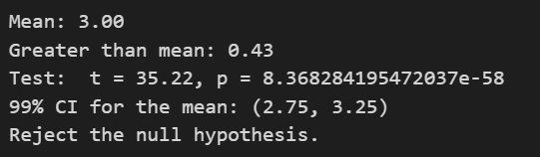
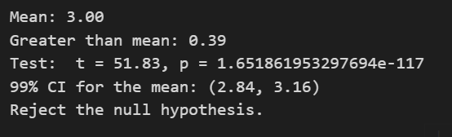
Performed hypothesis test and found confidence interval to know the given [‘bedrooms’] ’] null hypothesis is the majority of the houses have the [‘bedrooms’] less than the mean of the [‘bedrooms’] in the data set for 100 samples.
Performed hypothesis test and found confidence interval to know the given [‘bedrooms’] ’] null hypothesis is the majority of the houses have the [‘bedrooms’] less than the mean of the [‘bedrooms’] in the data set for 200 samples.

Slide 24
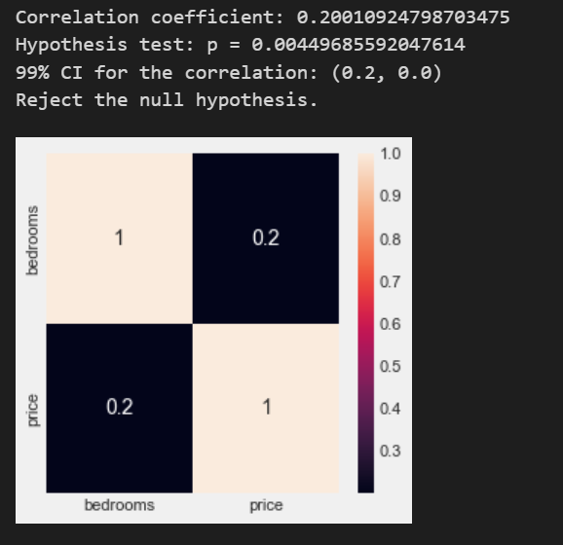
Performed correlation between two variables. One is a target variable like price and the other is our own variable like 'bedrooms’.

Slide 25
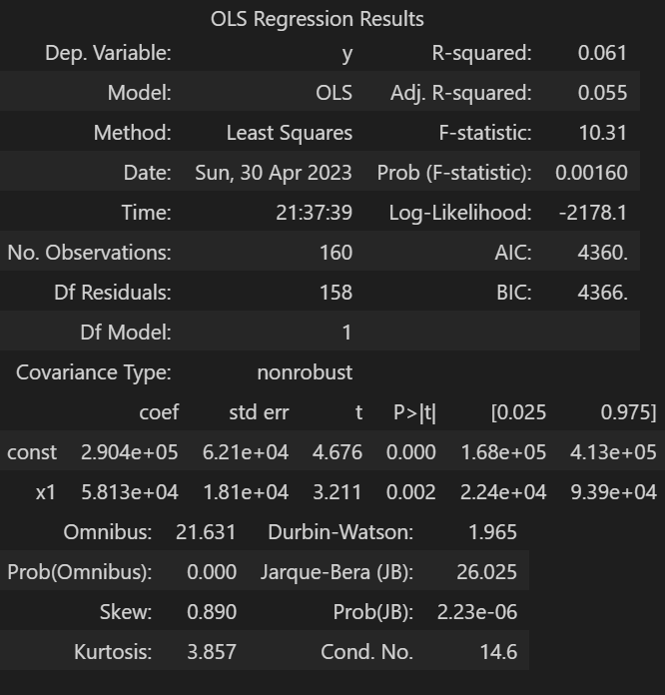
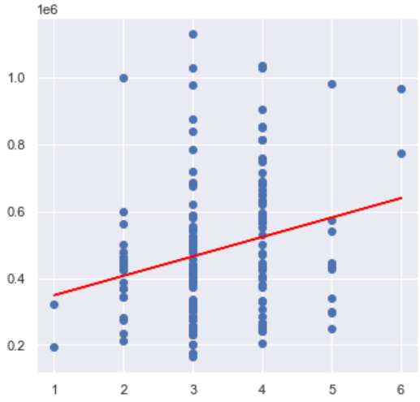
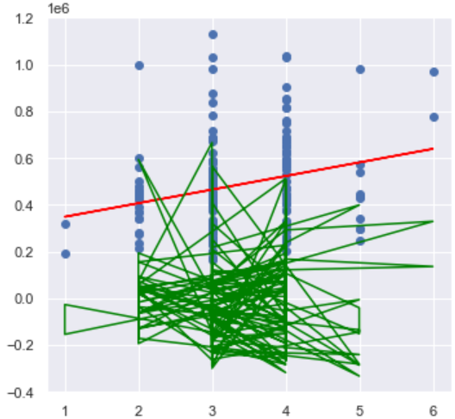
When using multiple variables[‘bedrooms’] to determine target variable(“Price”) using OLS model R2 score is: -0.08135849699103703

Slide 26
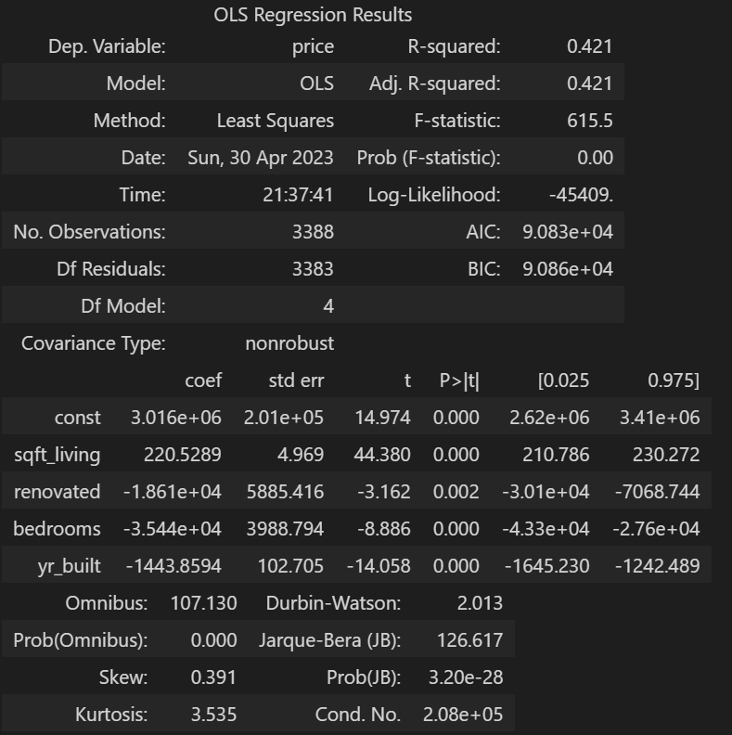
Adjusted R2 score for multi variables ['sqft_living', 'renovated', 'bedrooms','yr_built']is 0.4205257635079638
For multi regression equation.
The multi regression equation is : Y = 3.016e+06 + 220.5289 * (sqft_living) + -1.861e+04 * (renovated) + -3.544e+04 * (bedrooms) + -1443.8594 * (yr_built)

Slide 27
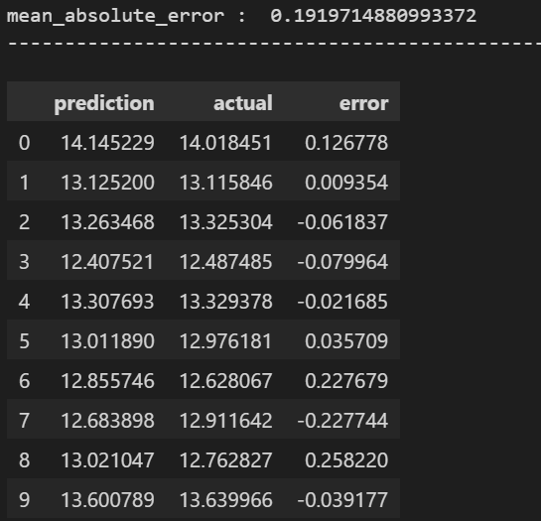
Overall Model Multi regression equation : Y = 3.521e+06 +bedrooms * -3.645e+04 + 3.493e+04 * bathrooms + 123.7904 * sqft_living + sqft_lot * -0.2185 + floors * 5.831e+04 + waterfront * 1.189e+05 + view * 3.238e+04 + condition * 2.37e+04 + sqft_above * 67.9539 + sqft_basement * 55.8364 + yr_built * -1795.9478 + renovated * 1548.2712

Slide 28
REFERENCES
https://www.sciencedirect.com/science/article/abs/pii/S0304393206001279?casa_token=rxkEyVnDILEAAAAA:-PAT1yegiflHpCfcGhoeffHHcVg8LVmtuHDB3DpBKgakbamXPrkz8VSSHOeUVKr1Hbpo7Cn7
https://www.aeaweb.org/articles?id=10.1257/aer.101.5.2108
https://onlinelibrary.wiley.com/doi/abs/10.1111/jmcb.12011?casa_token=FYjWzmV_vskAAAAA:TSRb81iCe-NrkW7h6L85jsWhmtJzUbqbJXh76WW6-Q3dstOcMo14H-JNPw2PY1sgBwjgrTNZ7mPnvQ
https://www.sciencedirect.com/science/article/abs/pii/S0378426609002088?casa_token=-INSzlJWZfEAAAAA:TSjTL3G1gHQOChwJ2rCBCDxr7RHAgJTE3b_UFLq_sYpZpDCVx8DkXwu6GuxgN97_vToSuNQZ
https://www.sciencedirect.com/science/article/abs/pii/S1051137796900182

Slide 29
THANK YOU!

